Slide 1


Feature Selection And Factor Analysis
Supervised by :
Dr.Doaa Mohamed

Slide 2






Get to Know Our Team
Mostafa Mamdouh
Ahmed Fawzi
Ahmed Fahim

Slide 3

Table of contents
01
importance of feature selection
06
Compare
02
07
supervised feature selection
factor analysis
03
08
Pre-requisites for factor analysis
Filter method
04
09
how to do factor analysis
wrapperd method
05
10
type of factor analysis
embedded method
11
conclusion

Slide 4






Importance of Feature Selection
Enhanced model Performance
By removing irrelevant features, models can achieve higher accuracy, better generalization, and improved performance.
Reduced Complexity
Simplifying models by reducing the number of features can make them faster to train and deploy, leading to efficiency gains.
Improving Model Generalization
By selecting the most relevant features from a dataset, feature selection can improve the generalization of an AI or LLM model
Reduced Overfitting
Feature selection helps prevent overfitting by reducing the number of features, leading to more robust and generalizable models.

Slide 5



Feature Selection Technique
01
02
Supervised
Feature Selection
Unsupervised
Feature Selection

Slide 6

Supervised Feature Selection
01
03
Filter-based
Embedded
These methods select features based on statistical measures and use feature ranking to select best feature based on rank or score, independent of the learning algorithm.
These method of feature selection that integrates the feature selection process into the training of a machine learning model. This means that the model itself performs feature selection as part of its learning process, rather than as a separate step before model training making them efficient and effective for model training.
supervised
02
Wrapper-based
These methods use a learning algorithm to evaluate the performance of different feature subsets, It follows a greedy search approach by evaluating all the possible combinations of features against the evaluation criterion

Slide 7




01
Filter-based

Slide 8


Filter-based Feature Selection
1
Data Preprocessing
The initial step involves cleaning, scaling, and transforming the data.
Feature Ranking
Features are ranked based on statistical measures, such as correlation , fisher score, mutual information, or chi-squared statistics.
2
Feature Selection
A threshold or cutoff point is applied to the ranked features, selecting those that meet the criteria for relevance.
3

Slide 9
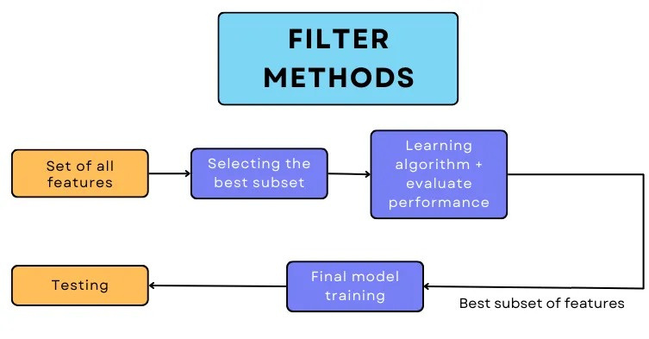

Slide 10
Filter Method
01
02
03
Information Gain
Chi Square
Fisher Score

Slide 11



1-Information Gain
Information gain calculates the reduction in entropy from the transformation of a dataset. It can be used for feature selection by evaluating the Information gain of each variable in the context of the target variable
Pros :
Cons :
Simple to Compute: IG is straightforward to calculate, making it easy to implement in machine learning algorithms.
Effective for Feature Selection: IG is particularly useful in decision tree algorithms for selecting the most informative features, which can improve model accuracy and reduce overfitting.
Efficient for Categorical Data:Information Gain works well with categorical data, which makes it suitable for decision trees and other models that handle such data types effectively.
Bias Towards Features with More Categories: Information Gain tends to favor features with a larger number of categories, regardless of their true predictive power. This is because features with more distinct values often result in a larger reduction in entropy, even if some categories are irrelevant or noise.
Limited for Continuous Data: Information Gain is not as effective with continuous (numeric) data unless it is discretized first. This preprocessing step can be cumbersome and may result in loss of information if not done carefully.
Ignores Feature Interactions: IG treats features independently and may not consider interactions between features, potentially missing important relationships that could improve model performance

Slide 12
2-Chi Square
The chi-square (χ²) test is a statistical method is used for categorical features in a dataset. We calculate Chi-square between each feature and the target and select the desired number of features with best Chi-square scores, we aim to select the features which are highly dependent on the response.
Pros :
Cons :
Simplicity and Ease of Use:The Chi-Square test is straightforward and easy to compute. It does not require complex mathematical transformations, making it accessible for those who are less experienced with advanced statistical methods.
Applicable to Categorical Data:It is particularly useful for analyzing categorical (nominal or ordinal) data, which is common in surveys, experimental studies, and market research.
Handles Large Datasets Well:The test is particularly powerful and reliable when used with large sample sizes, making it suitable for extensive surveys or large-scale experiments.
No Assumptions about Distributions:The Chi-Square test does not assume that the data follow a particular distribution, like normality. This makes it more flexible than parametric tests which require such assumptions.
Limited to Categorical Data:The test cannot be used for continuous data directly. Data must be binned or categorized before performing the test, which can result in loss of information.
Ignores Interaction Between Variables:The test evaluates associations between variables but does not account for interactions between multiple variables. Complex relationships can be missed if the test is applied naively to multivariate datasets.

Slide 13
3-Fisher Score
Fisher's Score, is a feature selection approach that ranks features based on their ability to differentiate various classes in a dataset, is to find features that maximize the distance between different class means while minimizing the spread (variance) within each class. Features that do this well will have a higher score
Pros :
Cons :
Simplicity: The Fisher Score is straightforward and easy to compute. It is based purely on the statistical properties (mean and variance) of the features and does not require complex mathematical operations.
No Need for Model Training: The Fisher Score does not require the training of any models. This makes it computationally less expensive compared to wrapper methods (which involve training a model for each feature subset).
Applicability in High-Dimensional Data: It can be applied to high-dimensional data where other complex methods may be computationally expensive.
Limited to Categorical Data: The test cannot be used for continuous data directly. Data must be binned or categorized before performing the test, which can result in loss of information.
Ignores Interaction Between Variables: The test evaluates associations between variables but does not account for interactions between multiple variables. Complex relationships can be missed if the test is applied naively to multivariate datasets.
Bias Toward Continuous Features: Fisher Score tends to work better with continuous features, and might not be as effective for categorical features unless they are properly encoded.
Sensitive to Outliers:Fisher Score relies on the mean and variance, which are sensitive to outliers. Extreme values can skew the score and lead to the wrong conclusion about a feature’s importance.

Slide 14

02
Wrapper-based Feature Selection

Slide 15


Wrapper-based Feature Selection
1
Generate Subsets
Various feature subsets are generated using techniques such as forward selection, backward elimination, or random search.
2
Evaluate Performance
The performance of each subset is evaluated using a chosen learning algorithm and a performance metric.
3
Select Best Subset
The subset that achieves the highest performance is selected as the optimal feature set.

Slide 16
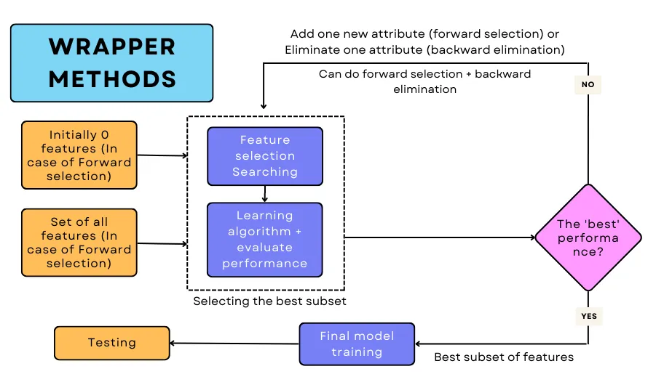

Slide 17
Wrappers Method
01
02
03
04
Forward feature selection
Backward Elimination
Exhaustive Feature Selection
Recursive Feature Elimination (RFE)

Slide 18
1-Forward feature selection
Forward Feature Selection is a feature selection technique that iteratively builds a model by adding one feature at a time, selecting the feature that maximizes model performance. It starts with an empty set of features and adds the most predictive feature in each iteration until a stopping criterion is met or performance decrease
Pros :
Cons :
Simplicity: The method is intuitive and easy to understand. It starts with no features and progressively adds features that improve model performance the most.
Considers Feature Interactions: Forward selection takes feature interactions into account. It might add features that may not seem important alone but become valuable when combined with other features
Effective in Low-Dimensional Data: It works well for smaller datasets with fewer features because it evaluates the contribution of each feature based on the model's performance, thus ensuring only important features
Computationally Expensive: Forward feature selection can be computationally expensive, especially for large datasets with many features. The process of evaluating models repeatedly for each new feature can be time-consuming.
Challenging with Highly Correlated Features: If two or more features are highly correlated, forward selection might select one and ignore the others, even though combining them might have led to better performance.

Slide 19
2-Backward Elimination
Backward elimination is a step-wise feature selection technique that starts with a full set of features and iteratively removes features one by one until the model performance reaches a peak
Pros :
Cons :
Less Risk of Missing Important Features: Because it begins with the full feature set, there is less chance of eliminating important features early in the process, compared to forward selection where important features could be overlooked at the start.
Takes Feature Interactions into Account: By starting with all features, backward elimination naturally captures and evaluates potential interactions between features, which may be important for the model’s performance.
Accurate for Small Datasets: it tends to work well for small datasets with a manageable number of features, where evaluating all features together from the beginning can lead to an optimal solution.
Computationally Expensive: Backward elimination can be computationally expensive, especially for large datasets with many features. It starts with all features and must evaluate the impact of removing each feature, which can be time-consuming.
Backward elimination can struggle with highly correlated features (multicollinearity). It might remove one of the correlated features arbitrarily, even though both together might contribute significantly to the model.

Slide 20
3-Exhaustive Feature Selection
This is the most robust feature selection method covered so far. This is a brute-force evaluation of each feature subset. This means it tries every possible combination of the variables and returns the best-performing subset
Pros :
Cons :
Guaranteed to Find the Optimal Subset: Since exhaustive selection evaluates all possible combinations of features, it is guaranteed to find the optimal subset of features that maximizes model performance for a given evaluation metric.
Best for Small Feature Sets: For small datasets with relatively few features, exhaustive feature selection can be highly effective and provide the best performance compared to other selection methods .
Thorough and Comprehensive: Because it evaluates every possible subset, it ensures no potentially useful feature combinations are overlooked, unlike greedy methods such as forward or backward selection.
Extremely Computationally Expensive: The biggest downside of exhaustive feature selection is its computational cost. there are 2n−12^n - 12n−1 possible feature subsets (excluding the empty set), which leads to an exponential growth in the number of evaluations as the number of features increases. This makes it infeasible for large datasets with many features .
Risk: Since exhaustive feature selection tries every possible combination, there is a higher risk of overfitting to the training data, especially if cross-validation is not used properly. The model might select a subset of features that fits the training data perfectly but does not generalize well to new data.

Slide 21
4-Recursive Feature Elimination (RFE)
Recursive Feature Elimination is an iterative feature selection method that works by recursively removing features from the dataset and evaluating the performance of a machine learning model at each step. It starts with all features and ranks them based on their importance or relevance to the target variable, and then removes the least important feature(s) and repeats the process until the desired model performance is reached.
Pros :
Cons :
Good for Medium-Sized Datasets: RFE is efficient enough to be used on medium-sized datasets with a moderate number of features, making it a practical choice for many real-world application .
Customizable: The number of features to keep can be specified by the user. This gives flexibility in controlling the final number of selected features based on model performance or other criteria.
RFE : can be applied to any model that provides some measure of feature importance (e.g., weights in linear models, feature importances in tree-based models), making it versatile across different machine learning algorithms.
Prone to Suboptimal Solutions: RFE uses a greedy approach, removing features one by one based on their current importance. Once a feature is eliminated, it cannot be reconsidered, which may lead to suboptimal feature sets if the interactions between features are complex.
Computationally Intensive: RFE can be computationally expensive, especially for large datasets or models with many features. It requires fitting the model multiple times as features are recursively eliminated, which increases the computational burden.
Performance Dependent on Model Type: The effectiveness of RFE depends on the underlying model used for feature evaluation. If the model struggles to estimate feature importance correctly, RFE may eliminate important features. This is particularly true for unstable models such as decision trees, which may produce different results with slight variations in the data.

Slide 22

03
Embedded Feature Selection

Slide 23
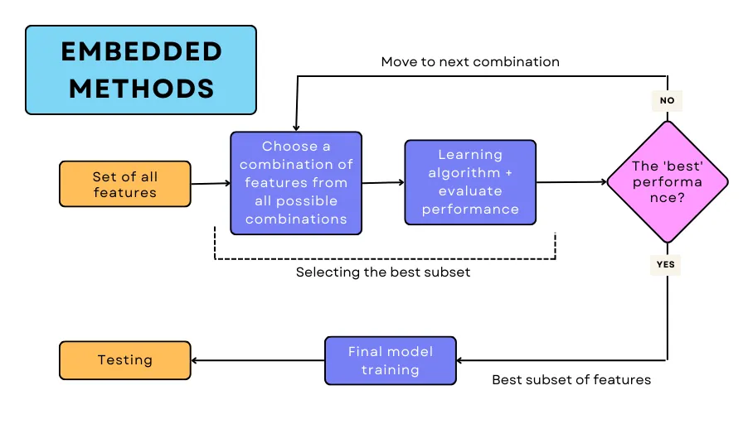
Feature selection is a process of selecting a subset of relevant features from the original set of features. The goal is to reduce the dimensionality of the feature space, simplify the model, and improve its generalization performance.
Feature extraction is a process of transforming the original features into a new set of features that are more informative and compact. The goal is to capture the essential information from the original features and represent it in a lower-dimensional feature space. Feature extraction methods can be categorized into linear methods and nonlinear methods.

Slide 24
Embedded Method
01
02
03
L1 Regularization (Lasso)
L2 Regularization
Random Forest

Slide 25
1-L1 Regularization (Lasso)
L1 regularization (Lasso) adds a penalty to the absolute values of model coefficients, causing less important feature coefficients to shrink to exactly zero. This leads to automatic feature selection
Pros :
Cons :
Automatic Feature Selection: Lasso can shrink coefficients of irrelevant features to zero, thus automatically performing feature selection.
Simplicity: Lasso models are simpler and easier to interpret due to the elimination of irrelevant features.
Good for High-Dimensional Data: It works well for datasets with a large number of features, especially when only a small subset of features is important.
Prevents Overfitting: By shrinking the coefficients of irrelevant features, Lasso can reduce the complexity of the model and help prevent overfitting.
Limited When All Features are Important: If all features contribute some value to the model, Lasso may not be ideal since it forces some coefficients to zero, potentially removing valuable features.
Bias in Coefficients: L1 regularization introduces bias by shrinking the non-zero coefficients, which can lead to underestimating the importance of the selected features.
L1 regularization: tends to select only one feature from a group of correlated features and ignores the others, which can result in loss of useful information from the excluded features.

Slide 26
2-L2 Regularization
l2 adds a penalty to the square of the model coefficients, Ridge shrinks the coefficients of less important features, but unlike Lasso, it does not shrink them to exactly zero. Instead, it reduces their impact without eliminating them.
Pros :
Cons :
Retains All Features: Unlike L1, Ridge retains all features by shrinking their coefficients rather than eliminating them, which can be beneficial if all features have some importance.
Useful for Small and Noisy Datasets: L2 regularization can help improve the model's performance when working with small datasets or noisy data by ensuring no feature is discarded entirely.
Useful for Small and Noisy Datasets: L2 regularization can help improve the model's performance when working with small datasets or noisy data by ensuring no feature is discarded entirely.
May Not Discard Irrelevant Features: Ridge regularization shrinks coefficients but may not eliminate irrelevant features entirely, which could lead to a model that still includes unnecessary variables.
No Feature Elimination: Ridge does not perform actual feature selection, as it never reduces coefficients to zero. All features are retained, making the model potentially less sparse and less interpretable.
Less Effective for Sparse Models: If the goal is to create a sparse model by selecting only the most important features, L2 regularization is less effective compared to L1 (Lasso).

Slide 27
3-Random Forest
Random Forest an ensemble learning method, is widely used for feature selection due to its inherent ability to rank features based on their importance, is a popular method that leverages the inherent properties of the Random Forest algorithm to identify the most important features in a dataset
Pros :
Cons :
Handles Complex Relationships: Random Forests can capture non-linear interactions between features, making them suitable for complex datasets.
Robust to Multicollinearity: They handle correlated features well because each decision tree is built on a random subset of features, reducing bias from multicollinearity.
Random Forests can process datasets with many features and identify the most important ones without the need for separate feature selection algorithms.
Versatile: They work for both classification and regression tasks, making them a flexible tool for different types of data.
Biased Toward Features with More Levels: Random Forests may give more importance to features with more categories or levels, even if they are not necessarily more informative.
Computationally Intensive: Training Random Forests, especially with large datasets or many trees, can be computationally expensive and time-consuming.
Less Interpretability: While feature importance is provided, Random Forests are less interpretable than linear models because they aggregate information across multiple decision trees.

Slide 28



COMPARE

Slide 29
Feature method
Filter Method:
Wrapper Method:
Embedded Method
Use for initial preprocessing and dimensionality reduction in high-dimensional datasets, especially when computational speed is crucial but not have good accuracy and help to understanding the rationale behind feature selection is crucial
Best suited for smaller datasets where feature interactions are important and computational cost is less of a concern and have a high accuracy are typically applied when accuracy is a priority over computation time
Use when you want a feature selection method tightly integrated with the model training process It's especially effective when you want to reduce model complexity without a separate feature selection step and when went to building complex models like Lasso or Random Forests that automatically select important features
VS
VS

Slide 30
difference between feature selection and feature extraction.
Feature selection
Feature extraction
is a process of selecting a subset of relevant features from the original set of features. The goal is to reduce the dimensionality of the feature space, simplify the model, and improve its generalization performance.
is a process of transforming the original features into a new set of features that are more informative and compact. The goal is to capture the essential information from the original features and represent it in a lower-dimensional feature space. Feature extraction methods can be categorized into linear methods and nonlinear methods.
VS

Slide 31

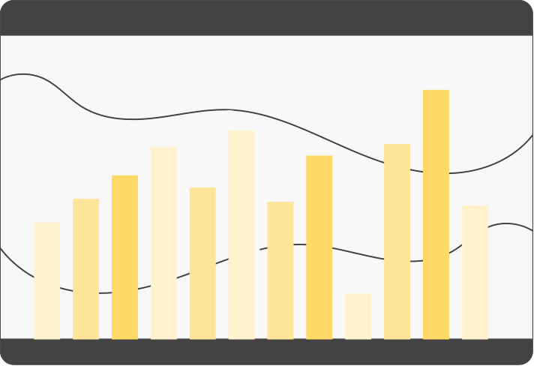


Factor analysis

Slide 32


INTRODUCTION
Factor analysis is a statistical technique used to identify underlying relationships between variables. It aims to reduce a large set of variables into a smaller set of factors or latent variables. These factors are thought to represent underlying constructs that explain the correlations among the observed variables.

Slide 33
Pre-requisites for factor analysis
Check The following pre-requisites before applying the factor analysis | Check The following pre-requisites before applying the factor analysis
We should apply factor Analysis on the large datasets to diminish the error in the final results. | ✓
The correlation between the factors and variables should be at least 0.30, as anything lower than this would imply a weak relationship between the variables. | ✓
The SMC(Squared Multiple Correlation) of the dataset needs to be checked, and variables that have issues with a singularity, i.e., SMC close to 0 and multicollinearity, i.e., SMC close to 1.0, should be removed from your dataset.
We should also remove outliers from the dataset | ✓
The dataset should be standard scaled, and we should convert the categorical features to numerical features.

Slide 34
How to do Factor Analysis (Factor Analysis Steps)?
1
5
Determine the Suitability of Data for Factor Analysis
Interpret and Label the Factors
2
Choose the Extraction Method
6
Compute Factor Scores
(if needed)
3
Factor Extraction.
7
Report and Validate the Results
4
Factor Rotation

Slide 35


1- Determine the Suitability of Data for Factor Analysis
Bartlett’s Test
Kaiser-Meyer-Olkin (KMO) Measure
Check the significance level to determine if the correlation matrix is suitable for factor analysis.
Bartlett’s Test is often used in conjunction with the Kaiser-Meyer-Olkin (KMO) measure to assess the adequacy of data for factor analysis. While the KMO measure assesses the overall adequacy, Bartlett's test specifically examines the interrelationships among variables.
Purpose: This test checks whether your correlation matrix significantly differs from an identity matrix (i.e., a matrix where all the diagonal elements are 1 and off-diagonal elements are 0, indicating no correlations among variables).
Interpretation
Significant Result (p-value < 0.05): The test suggests that your data has significant correlations among variables, making it suitable for factor analysis.
Non-Significant Result (p-value ≥ 0.05): The test suggests that the correlations among your variables are not strong enough for factor analysis.
Verify the sampling adequacy. A value greater than 0.6 is generally considered acceptable.
Range: The KMO value ranges from 0 to 1.
- KMO ≥ 0.90: Excellent
- 0.80 ≤ KMO < 0.90: Good
- 0.70 ≤ KMO < 0.80: Adequate
- 0.60 ≤ KMO < 0.70: Mediocre (minimum acceptable level)
- KMO < 0.60: Unacceptable, factor analysis should not be conducted.
Interpretation
High KMO Value: Indicates that the data is likely to yield distinct and reliable factors, meaning that factor analysis is appropriate.
Low KMO Value: Suggests that the data may not be suitable for factor analysis, as the variables do not share enough common variance.
If both tests indicate favorable results (significant Bartlett’s test and KMO > 0.60), you can proceed with factor analysis confidently. If either test indicates issues, you might need to reconsider using factor analysis or make adjustments to your data.

Slide 36


2-Choose the Extraction Method
Principal Component Analysis (PCA)
Principal Axis Factoring (PAF)
PCA is primarily used for data reduction.
The goal is to transform the original variables into a smaller set of uncorrelated components that retain most of the variance from the original data.
Ideal when you want to reduce the dimensionality of your data while preserving as much information as possible.
When to Use: Choose PCA when your primary objective is to summarize the data with fewer components, or when you want to use the components in further analyses (e.g., regression or clustering).
is used when the main goal is to uncover the underlying latent factors that explain the correlations among observed variables.
Usage: Ideal for identifying the underlying constructs or factors that influence the observed variables, making it suitable for theory building and exploring latent structures.
When to Use: Choose PAF when your primary goal is to identify and understand the latent factors that cause the correlations among your observed variables.
OR
Summary:
PCA : is best when your goal is data reduction—to reduce the number of variables while retaining as much original information as possible.
PAF : is best when your goal is to identify underlying factors—to discover the latent variables that explain the patterns of correlations in your data.

Slide 37

3-Factor Extraction Process:
Use the chosen extractsion method(PCA or PAF) to identify the initial factors.
Kaiser Criterion:
Extract eigenvalues to determine the number of factors to retain. Factors with eigenvalues greater than 1 are typically retained in the analysis.
Retain Factors with Eigenvalues > 1: This is the common rule known as the Kaiser criterion.
Factors with eigenvalues greater than 1 explain more variance
.
Compute Initial Factor Loadings
Factor Loadings: Represent the correlation coefficients between the variables and the factors. They indicate how much of the variance in each variable is explained by the factor, After determining the number of factors to retain, compute the factor loadings.
Interpretation: Higher factor loadings (typically > 0.4 or 0.5) suggest a stronger association between the variable and the factor. Loadings close to 0 indicate weak or no association.
Factor Matrix: This matrix contains all the factor loadings for each variable on each factor. The initial factor matrix shows these loadings before any rotation.
Scree Plot: Plot the eigenvalues in descending order to visualize the point where the plot levels off (the “elbow”) to determine the number of factors to retain
Summary:
Run PCA or PAF: to identify the initial factors
Examine Eigenvalues: Look at the eigenvalues output to decide how many factors to keep.
Factor Loadings: Analyze the initial factor loadings to understand which variables are associated with each factor.

Slide 38

4-Factor Rotation
Factor Rotation
01
02
Orthogonal Rotation
Oblique Rotation
Quartimax Rotation
Promax Rotation
Oblimin Rotation
Varimax

Slide 39
1- Orthogonal Rotation
Varimax
Quartimax Rotation
Maximizes the variance of squared loadings of a factor across variables. This often results in a solution where each variable loads highly on one factor and has low loadings on others, making interpretation straightforward.
it tries to spread out the loadings so that each factor has some variables with very high loadings (close to 1) and others with very low loadings (close to 0)
simplifies the structure by concentrating each factor's loadings on fewer variables, which can help in understanding the factors but might not achieve as clear a separation as Varimax.
Initial Factor Loadings (Before Rotation)
Suppose the initial factor loadings matrix looks like this:
F1: V1 (0.5), V2 (0.6), V3 (0.4), V4 (0.5), V5 (0.3)
F2: V1 (0.4), V2 (0.3), V3 (0.7), V4 (0.6), V5 (0.5)
F3: V1 (0.3), V2 (0.4), V3 (0.2), V4 (0.3), V5 (0.8)
Applying Quartimax Rotation
After applying Quartimax rotation, the factor loadings might be adjusted to:
F1: V1 (0.8), V2 (0.2), V3 (0.1), V4 (0.1), V5 (0.3)
F2: V1 (0.2), V2 (0.7), V3 (0.6), V4 (0.5), V5 (0.4)
F3: V1 (0.1), V2 (0.2), V3 (0.2), V4 (0.2), V5 (0.9)
Interpretation
In this rotated matrix:
F1: V1 has a high loading (0.8) on F1, while V2, V3, and V4 have low loadings. V5 has a moderate loading. This indicates that F1 is primarily associated with V1.
F2: V2 and V3 have high loadings on F2 (0.7 and 0.6, respectively), while V1, V4, and V5 have lower loadings. This suggests that F2 is mainly associated with V2 and V3.
F3: V5 has a high loading (0.9) on F3, while the other variables (V1, V2, V3, V4) have much lower loadings. This indicates that F3 is primarily associated with V5.
Example :
Initial Factor Loadings (Before Rotation)
F1: V1 (0.6), V2 (0.4), V3 (0.5), V4 (0.3)
F2: V1 (0.4), V2 (0.5), V3 (0.6), V4 (0.7)
Applying Varimax Rotation
Varimax Rotation aims to maximize the variance of squared loadings of each factor across variables. It simplifies the factor structure by making each variable load highly on one factor and low on others.
Rotated Factor Loadings (Varimax):
F1: V1 (0.8), V2 (0.2), V3 (0.2), V4 (0.1)
F2: V1 (0.1), V2 (0.7), V3 (0.8), V4 (0.9)
Interpretation (Varimax):
F1 has high loadings on V1 and very low loadings on V2, V3, and V4.
F2 has high loadings on V2, V3, and V4, and very low loading on V1.

Slide 40
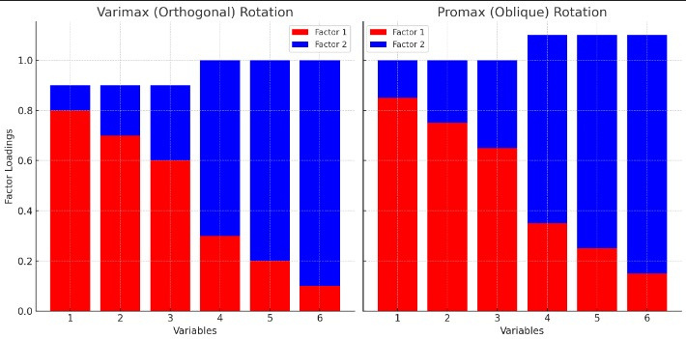
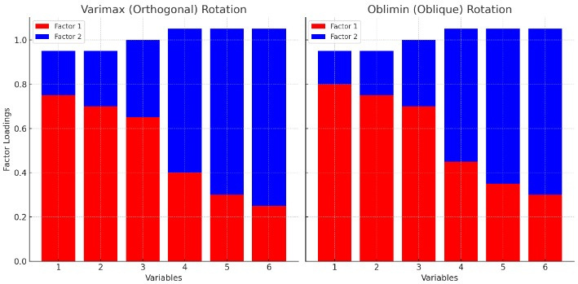
2- Oblique Rotation
Oblimin Rotation
Promax Rotation
Oblimin is a more sophisticated oblique rotation method that offers greater flexibility in adjusting the degree of correlation between factors.
It is part of a family of rotations that includes a parameter (delta) to control the level of correlation allowed between factors.
Delta Parameter: Delta (Δ) is a key element of Oblimin rotation. It determines the extent of correlation between factors:
Delta = 0: This makes Oblimin equivalent to Varimax rotation, which assumes that factors are uncorrelated (orthogonal).
Delta > 0: Encourages factors to be more correlated. Higher values of delta increase the freedom for factors to correlate.
Delta < 0: Restricts the correlation between factors, making them less likely to be correlated.
Step 1: Initial Varimax Rotation: Promax begins by performing a Varimax rotation. This step simplifies the factor structure by making each factor as distinct as possible under the assumption that they are uncorrelated.
Step 2: Procrustes Rotation: Promax then applies an oblique transformation (Procrustes rotation), which allows the factors to correlate. This step adjusts the factor loadings to reflect the true correlations between factors.

Slide 41
5-Interpret and Label the Factors
interpreting and labeling factors after a rotation (whether Varimax or Promax) involves examining the factor loadings and identifying patterns in the variables that load highly on each factor.
Step 1: Examine Factor Loadings
- After performing a factor rotation (e.g., Varimax, Promax, Oblimin), you'll have a rotated factor matrix, which shows the loadings of each variable on the extracted factors. These loadings indicate
how strongly each variable is associated with each factor.
- High Loadings: Focus on the variables that have high loadings (typically greater than 0.4 or 0.5) on a particular factor. These variables are most strongly associated with that factor.
- Low Loadings: Variables with low loadings on a factor are less related to that factor and may not be as relevant
Step 2: Identify Variables with High Loadings on Each Factor
- For Factor 1, Variables 1, 2, and 3 have high loadings (above 0.6). These variables contribute more to Factor 1.
- For Factor 2, Variables 4, 5, and 6 have high loadings (above 0.6). These variables contribute more to Factor 2.
Step 3 :Identify Common Themes:
- Look for common themes among the high-loading variables to determine what each factor represents.
Step 4 :Assign Meaningful Labels
- Based on the identified themes, assign concise and descriptive labels that accurately reflect the underlying constructs of each factor.
Conclusion :
Examine the factor loadings to identify which variables strongly associate with each factor.
Identify common themes among the variables with high loadings on each factor.
Assign meaningful labels to each factor that reflect the underlying constructs.

Slide 42
6-Compute Factor Scores :
involves calculating a score for each individual that represents their value on each of the identified factors
Factor Scores: These are composite scores that summarize an individual's position on each factor. They are derived from the weighted combination of the original variables that load on the factor.
Steps to Compute Factor Scores:
Let's walk through the computation of factor scores using the Regression Method.
Standardize the Data: Ensure the data is standardized (mean of 0 and variance of 1) before computing factor scores, especially if the variables have different units or scales.
Factor Loadings Matrix: Use the factor loadings from the rotated factor solution (e.g., after Promax rotation).
Score Coefficient Matrix: Invert the factor loading matrix to obtain the scoring coefficients.
Compute Factor Scores: Multiply the standardized data by the score coefficient matrix to get the factor scores for each individual.
Purpose: Factor scores can be used in subsequent analyses, such as regression(Customer Loyalty=β0​+β1​Factor Score 1+β2​Factor Score 2+…+ϵ )or clustering(Cluster=k-means(Factor Scores)), to represent the underlying dimensions (factors) identified in your factor analysis.
7- Report and Validate the Results :
Report and Validate the Results
Report the final factor structure, including factor loadings and communalities.
Validate the results using additional data or by conducting a confirmatory factor analysis if necessary

Slide 43

Type of Factor Analysis
Confirmatory Factor Analysis (CFA)
Exploratory Factor Analysis(EFA)

Slide 44
Exploratory Factor Analysis(EFA)
is a statistical technique used to identify the underlying relationships between variables in a dataset. It helps to uncover the structure of data by grouping variables that are correlated with each other into factors
Pros :
Cons :
Identifying Structure: It uncovers the underlying structure of data, which can be useful in developing theories or identifying key patterns.
Data Reduction: EFA helps in reducing a large number of variables into fewer factors, making data more manageable and interpretable
Flexibility: EFA does not require pre-specified models, making it suitable for exploratory research where the relationships among variables are unknown
Complexity: EFA can be complex and requires careful decision-making regarding the extraction method, rotation method, and number of factors.
Sample Size Requirement: EFA typically requires a large sample size to produce stable and reliable factor solutions.
Overfitting Risk: There’s a risk of overfitting the model to the data, especially if too many factors are extracted.

Slide 45
Confirmatory Factor Analysis (CFA)
is a statistical technique used to test whether a set of observed variables fits a hypothesized factor structure. Unlike Exploratory Factor Analysis (EFA), which explores potential underlying structures, CFA is used to confirm or validate a pre-specified factor structure.
Pros :
Cons :
Model Validation: CFA provides a formal test of the fit between the hypothesized model and the observed data, helping to validate the theoretical structure.
Flexibility: CFA allows for complex models, including multiple factors, correlated factors, and higher-order factors, providing flexibility in modeling various types of data structures.
Hypothesis Testing: Allows researchers to formally test hypotheses about the factor structure, such as the number of factors, the loadings of specific variables, and the correlations between factors.
Limited Exploratory Capability: Unlike EFA, CFA is not suitable for exploring the data for unknown factor structures. It can only test pre-specified models, limiting its usefulness in exploratory research.
Rigidity: CFA is less flexible than EFA in that it requires a predefined model. This rigidity means that if the model does not fit well, the researcher must either revise the model based on theoretical considerations or consider alternative models
Sensitivity to Data Quality: CFA is sensitive to the quality of the data. Issues such as non-normality, outliers, or missing data can adversely affect the results and model fit.

Slide 46
Conclusion
Feature selection and factor analysis are critical techniques in the preprocessing pipeline of machine learning and statistical analysis. Feature selection focuses on identifying and retaining the most important features from the dataset, leading to simpler, more interpretable models with improved generalization and reduced overfitting.
On the other hand, factor analysis serves as a dimensionality reduction technique, uncovering latent variables that explain the underlying relationships between observed variables. It helps in simplifying complex datasets by capturing the variance through fewer factors.
Together, these methods allow us to better understand the data's structure, improve model performance, and streamline the overall analysis process. Choosing the right approach depends on the problem at hand, but both techniques are vital for building efficient and effective models in data science.

Slide 47



Thanks!
Do you have any questions?

